Slide 1

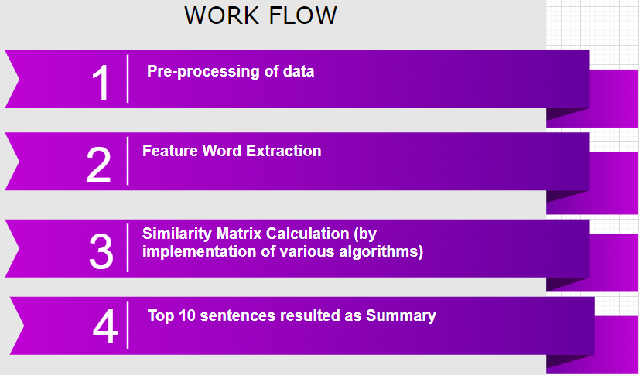
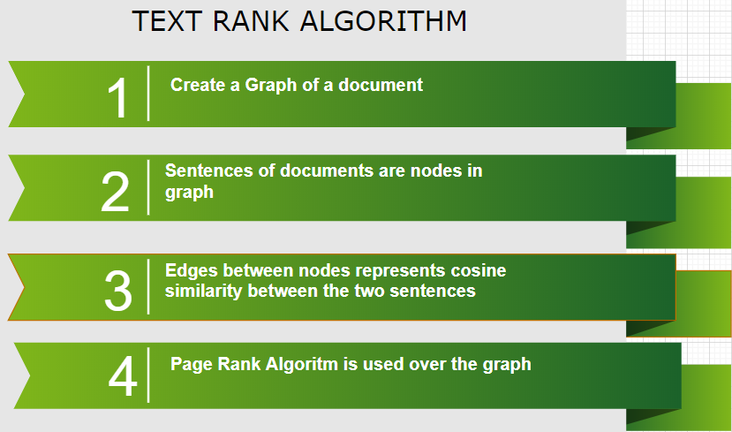
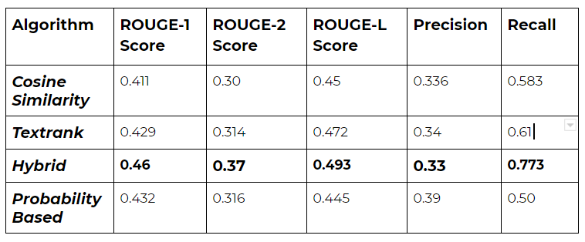
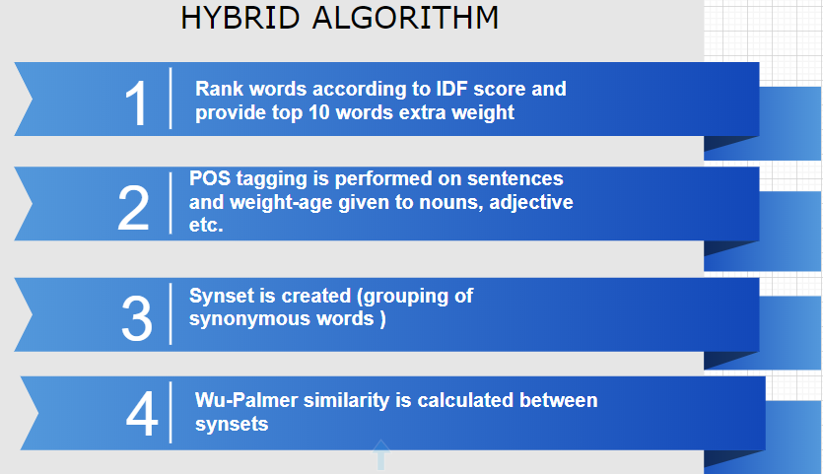
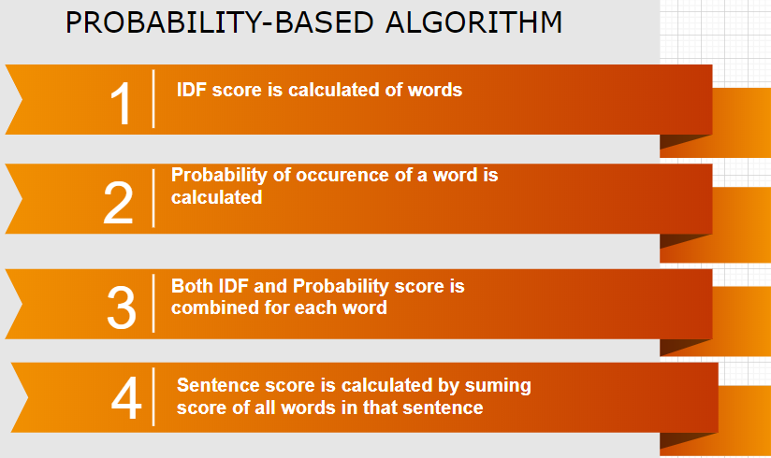
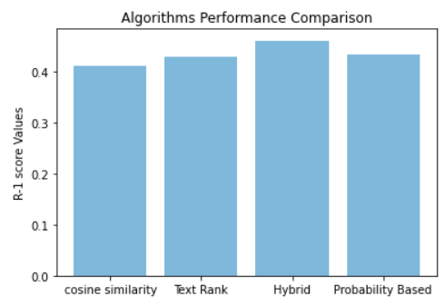
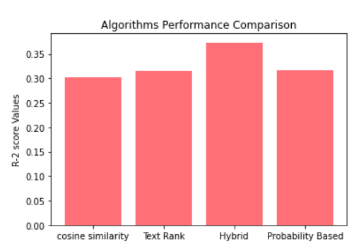
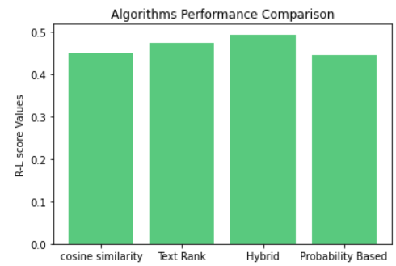
Live Summarization (Streaming Data)
Mohd. Zartab Ali Rohit Ghai Dhawal Singh Pundir
MT19041 MT19105 MT19120
zartab19041@iiitd.ac.in rohit19105@iiitd.ac.in dhawal19120@iiitd.ac.in
PROBLEM DEFINITION
INTRODUCTION
BASELINE
PROPOSED ALGORITHMS
In today’s world, a lot of textual data is generated via various platforms such as social media, blogs, news articles, web pages, tweets etc. This data is increasing day by day. Most of this data is unstructured and it takes a lot of time and human effort to navigate through the data to get useful results. There is a need to reduce this type of data to a shorter version so that readers can easily and quickly extract the useful information from that, and this can be achieved by text summarization. We are extending this problem of text summarization to summarize live streaming data such as data from twitter and other blogging sites.
Document Summarization or Text Summarization is the process of creating a concise summary of the document preserving its important information and its meaning. Summarization reduces the text by eliminating the less useful information that helps the reader to quickly find required information. There are two ways to do the above task:-
Abstractive Summarization
Extractive Summarization
Abstractive Summarization methods generate sentences based on semantic representation. It uses natural language generation techniques to produce a summary which is closer to what human readers generate while reading a document.
Extractive Summarization methods work by selecting a subset of words, sentences and phrases from the original document to generate a summary.
So as a baseline model, we developed the tf-idf vector and cosine similarity methods to rank sentences of a particular document in its summary. To start with, tweets are combined to form a document, pre-processed and sentences are extracted. Vectorization is applied and we have maintained a dictionary for every word which contains idf value. A vector of [1 X N] is maintained for every sentence which contains tf-idf value for each word in the sentence, here N is the size of the vocabulary.
Cosine score is calculated for a sentence with respect to all sentences in that document. Each score is normalized using the length of the sentences.
sentence score(i)= _{for each j} Σ(cosine-similarity(score _{I j} )) / N
where N is the total number of sentences in the document.
After sorting all the sentences with respect to cosine score top root N sentences will be output by the system where N is the number of total sentences in a document. Root N document is taken to maintain the size of summary proportional to document size.
EVALUATION CRITERIA
To evaluate baseline & other proposed models, we used ROUGE - Recall-Oriented Understudy for Gisting Evaluation. It is specifically used for evaluating automatic summarization of texts. It compares automatically produced summary and a set of reference summaries (produced by humans) i.e. ground truth. For generating the ground truth, we manually summarize some of the documents.
In ROUGE, recall is defined as how much of reference summary the system summary is recovering or capturing. So, considering individual words, Recall = Number of Overlapping Words
Total Words in Reference Summary
So, by combining these 3 types of ROUGE scores are calculated. These are ROUGE-N, ROUGE-L & ROUGE-S.
ROUGE - 1 (R1) : It measures unigram overlap ratio between the texts.
ROUGE - 2 (R2) : It measures the bigram overlap ratio between the texts.
ROUGE - L (RL) : It measures the longest matching subsequence of words using LCS.
Figure 1. ROUGE Evaluation Matrix based on different algorithm used
Charts: Comparison of ROUGE scores for different algorithms

